Slide 1
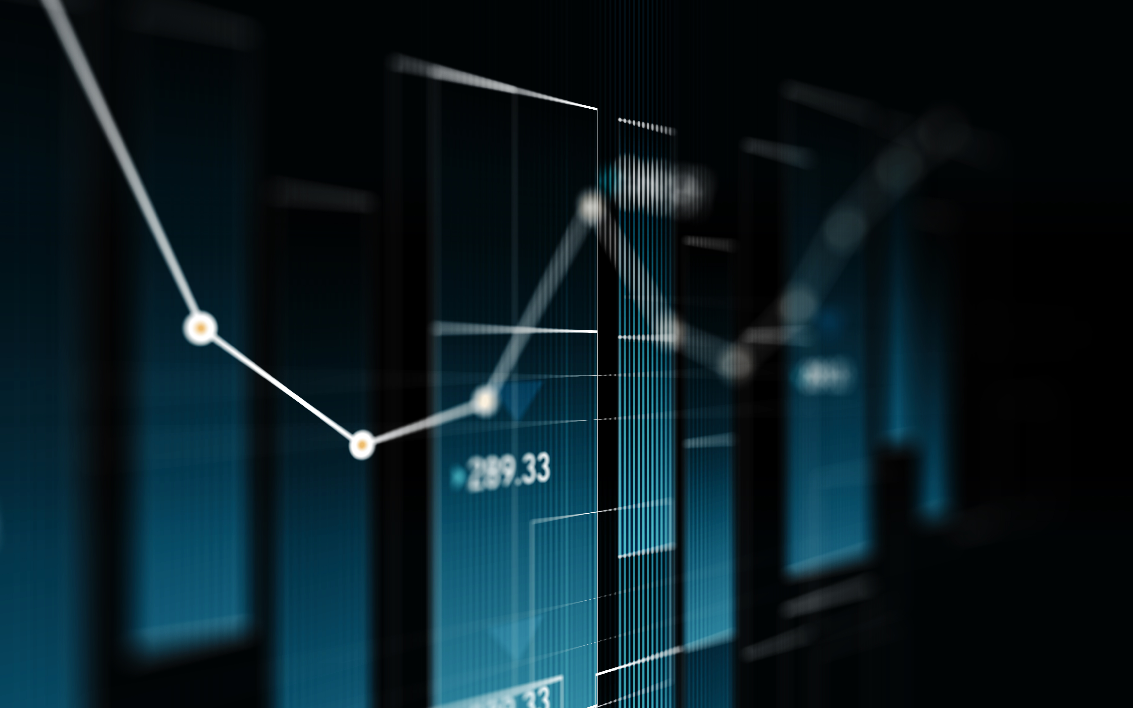
LIFE EXPECTANCY PREDICTION
MUHAMMED SHIBIL C V

Slide 2
OBJECTIVES
To develop a predictive model that uses demographic, medical, lifestyle, and environmental data to predict an individual's life expectancy.
To design a user-friendly interface for individuals, healthcare providers, financial advisors, insurance companies, and employers to access and use the tool.
To incorporate machine learning and artificial intelligence techniques to improve the accuracy of predictions.

Slide 3
Benefits:
Life expectancy refers to the average number of years that a person is expected to live based on statistical data. Factors that can affect life expectancy include genetics, lifestyle choices, access to healthcare, and environmental factors. Life expectancy can vary greatly between different countries and populations.

Slide 4
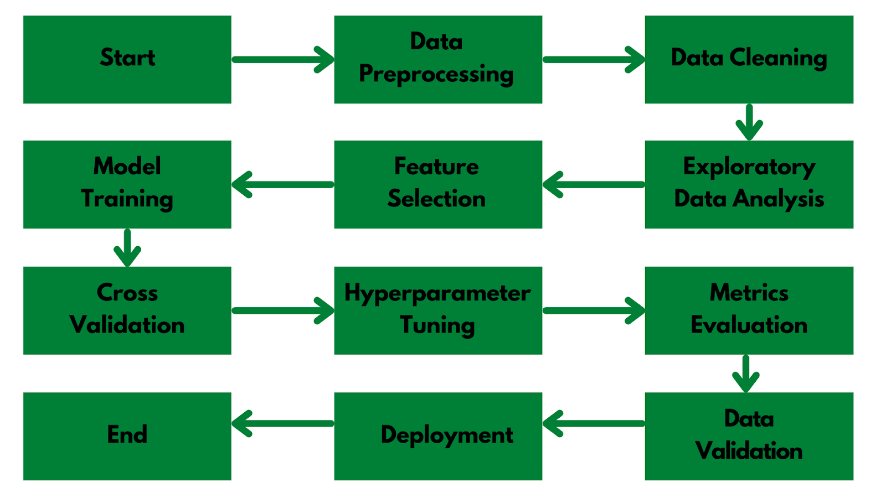
Architecture

Slide 5
Frequent Q&A
Q) What is the source of the data?
Data was collected from Kaggle, but city specific data can be collected from Central Board of Pollution website.
Q) What is the complete flow of your project?
Refer to slide no 4 for better understanding.
Q) What techniques were you using for data pre-processing?
In data pre processing, we analyzed the data, found the important features, and based on the domain knowledge, we eliminated the unnecessary columns. We also tried to fill Missing Values with mean, median and mode but still the data have the same correlations. Thus removing the columns with high NaN values was the better option for us.

Slide 6
Q) How did you choose the model?
After implementing hyper parameter tuning, we were able to do model selection based on the metrics and how it was performing on unseen data. The final model we chose was Random Forest Classifier.

Slide 7
Q) What are the different stages of deployment?
When the model was ready, we deployed the model using Streamlit on Heroku and performed some test.
We added the common values or ranges of each parameter to better help the user to select the value.
We then created the Explore page with the help of our EDA notebook where we embedded different types of graphs for each parameters.
We then added the animations and improved the user interface.
Once everything was finalized, we deploy it in production.

